Slide 1


- - introduction
Lecture 3

Slide 2
What is Latex?
Pronounced lā-tek
Based on TeX – a (low level) programming language
LaTeX is a file composed of TeX macros and commands that are compiled to produce the final document.
LaTeX is widely used by mathematicians and scientists as it is relatively easy to produce professional standard documents with large quantities of equations/tables/figures/references.
LaTeX is NOT a word processor! e.g. MS Word

Slide 3
Why learn latex?
LaTeX can take some time to learn to use. However, when you are comfortable with it, it is a quick and easy way to type up technical and mathematical documents.
It is particularly good at typesetting equations!
Referencing and compiling bibliographies is simpler than in a word processor.
The software is free to access and use.
Downside: No spell check!

Slide 4
Latex compiler
LaTeX documents are produced using a compiler. MiKTeX is one such compiler.
The text editor environment is where the users will type their work. Text editors are linked to a compiler, after which the desired document will be produced; often in PDF format.
We will use TeXworks as our text editor that is automatically linked with MiKTeX.
TeXworks files must be saved prior to compiling. The extension is .tex

Slide 5
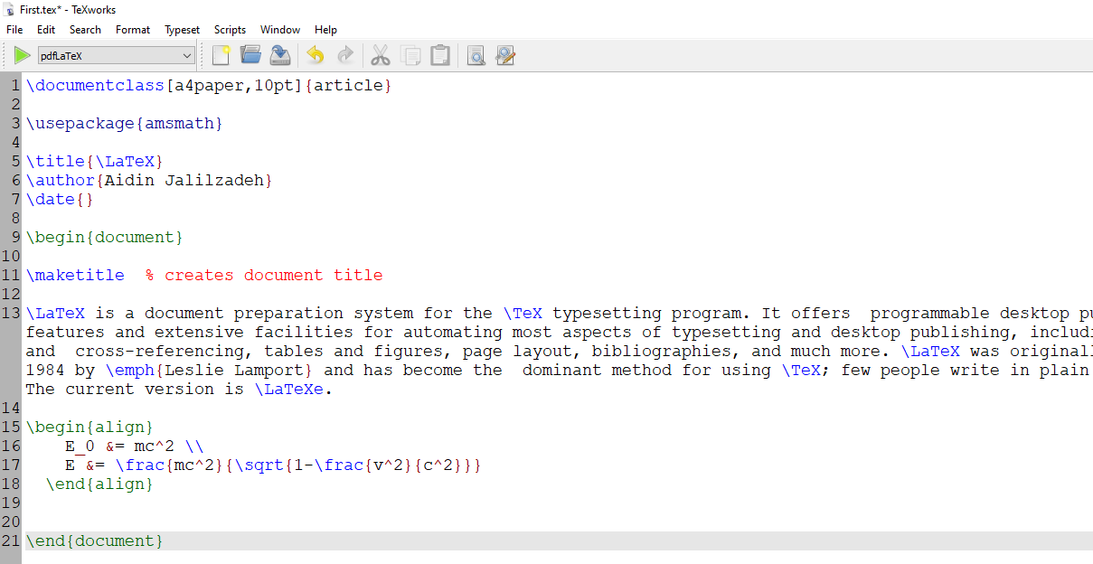
Editor environment
Compiler button
preamble
body/text

Slide 6
syntax
Every command begins with backslash sign: \
Format: \command_name[optional instructions]{essential instructions}
\documentclass[a4paper,10pt]{article}
To add comments use % sign

Slide 7
Commenting
comment

Slide 8
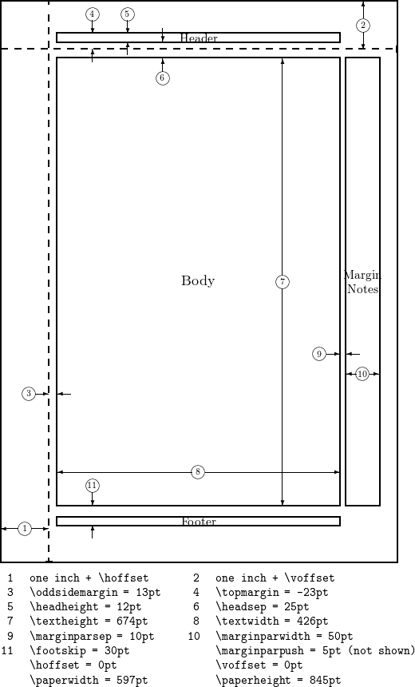
Page set-up (margins)
Margins:
The white space on either side of
each page and top and bottom.
In preamble type:
\usepackage[margin=2cm]{geometry}

Slide 9
Title
In Preamble:
\title{whatever your title is}
\author{your name}
\date{\today} % \date{} shows no date
\begin{document}
\maketitle
\end{document}

Slide 10
Page set-up (sectioning)
\section{title}
\subsection{title}
\subsubsection{title}

Slide 11
Page style (headers/page numbering)
\pagestyle{empty}
No headers; no page numbers
\pagestyle{headings}
Headers and page numbers
\pagestyle{fancy}
Fancy Headers
For fancy headers we need to use a special package in the preamble!
\usepackage{fancyhdr}

Slide 12
Page set-up (paragraphs)
\setlength{\parindent}{0cm}
Sets an indentation at the start of each paragraph
\setlength{\parskip}{9pt}
Sets a vertical distance between paragraphs

Slide 13
Font sizes

Slide 14
Font effects

Slide 15
Mathematics: type-setting/equations
Mathematical expressions can appear in two ways:
Inline: within the text environment
The equation of a straight line is given by $y=mx+b$ where the slope is $m$.
Syntax: insert inline expression between $ … $
\usepackage{amsmath,amssymb}

Slide 16
Mathematics: type-setting/equations
Mathematical expressions can appear in two ways:
Display Style: on a new line with equation number
The equation of a straight line is given by
\begin{equation}
y=mx+b
\end{equation}

Slide 17
Mathematics: type-setting/equations
Equation Array: for multi-line expressions
Multi-line equations are like:
\begin{eqnarray}
3x+7y & = & -10 \\
x-2y & = & 0 \\
x^3-y^2 & = & 1
\end{eqnarray}

